Slide 1

#31b: A 117 EMERGENCY COMMUNICATION PLATFORM FOR ABUSE REPORT IN A MOBILE APPLICATION

Slide 2






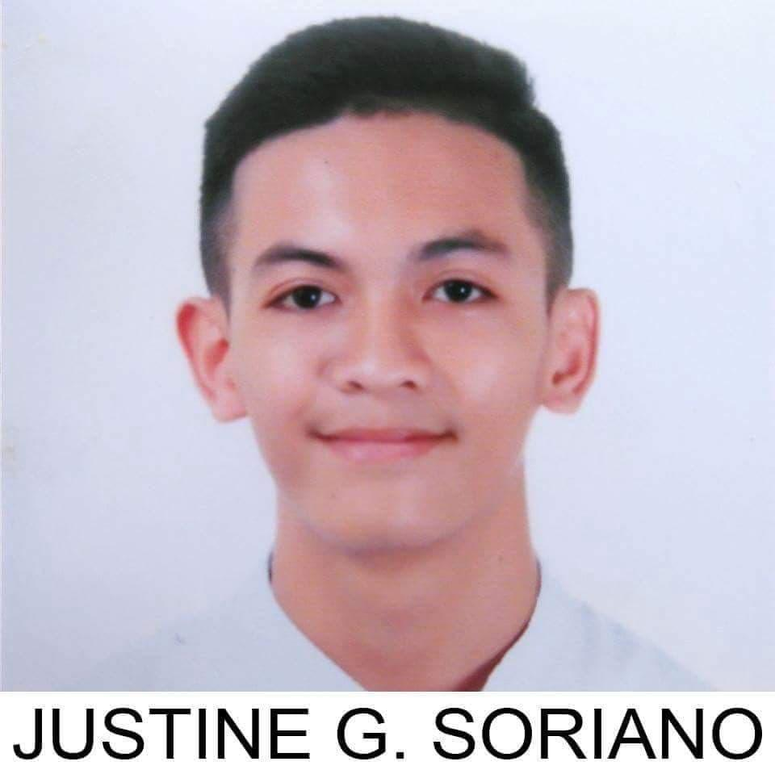

RESEARCHERS
BSIT 4A- CO2
ALONZO, ARLENE GRACE C.
RESEARCH ADVISER

Slide 3

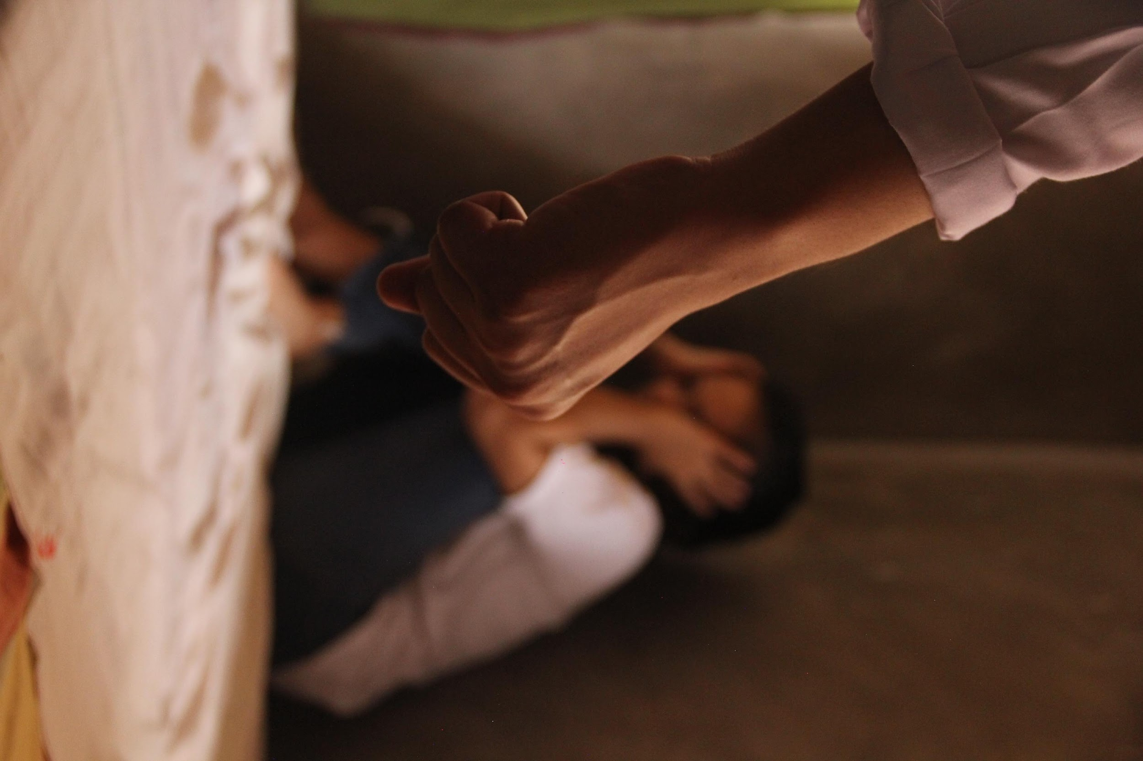
INTRODUCTION
ABUSE
“Is defined as an act of violence and/or maltreatment towards a person or things.”

Slide 4

INTRODUCTION
Republic Act No. 9262
“Anti-Violence Against Women and Their Children Act of 2004”
4 TYPES:
Physical
Sexual
Psychological
Economic

Slide 5
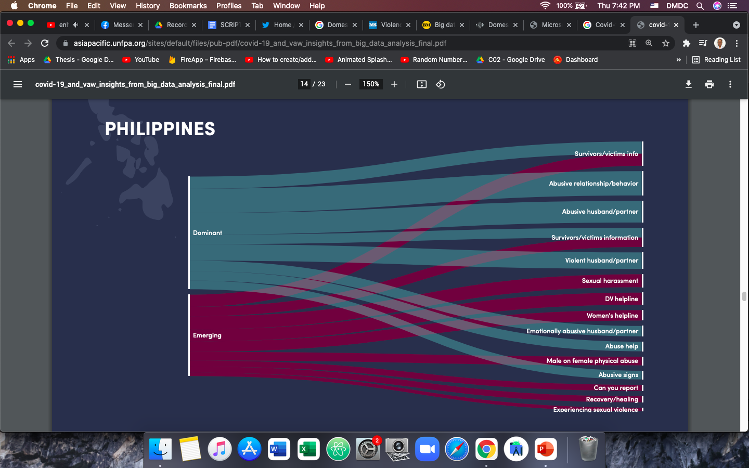
COVID-19 AND VIOLENCE AGAINST WOMEN: THE EVIDENCE BEHIND THE TALK
Insight from big data analysis in Asian Countries
Emerging refers to low volume of searches with high growth in the reference period.
Dominant refers to high volume of searches with high growth during the reference period.
Reference link: https://asiapacific.unfpa.org/en/publications/covid-19-and-violence-against-women-evidence-behind-talk

Slide 6
#31b: A 117 EMERGENCY COMMUNICATION PLATFORM FOR ABUSE REPORT IN A MOBILE APPLICATION

Slide 7
RESEARCH OBJECTIVES

Slide 8
RESEARCH OBJECTIVES
PROVIDE CONTACT INFORMATION
Indicating the available Emergency Hotlines and office location of the Municipal Police Stations.
PROVIDE A MOBILE APPLICATION
That will be able to help the user to easily file or report an abuse.
PROVIDE ACCURATE DATA OF CASES
To deliver support or comfort service to the victims, that can raise awareness with the discrete classification of abuse.

Slide 9
METHODOLOGY

Slide 10

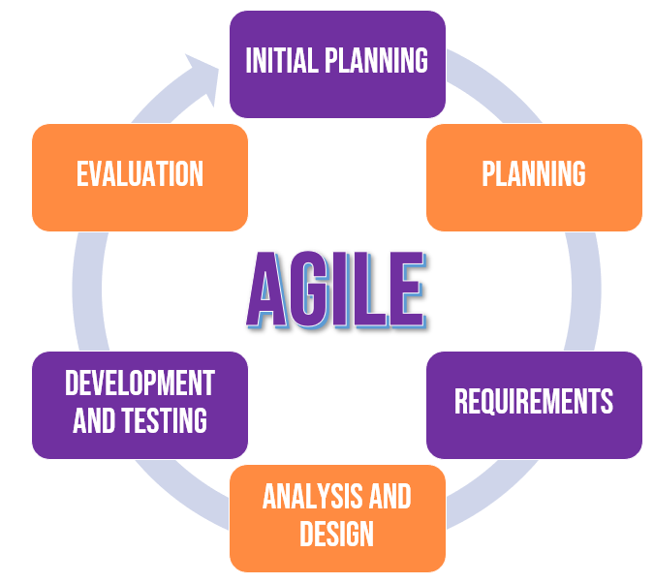
METHODOLOGY
SYSTEMS DEVELOPMENT
METHODOLOGY
RESEARCH DESIGN
Quantitative

Slide 11
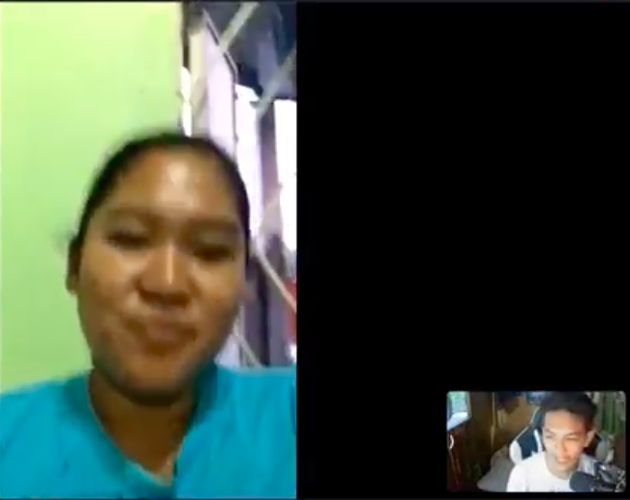

RESEARCH INSTRUMENT
METHODOLOGY
Interviewed a former Women and Children Protection Desk (WCPD) Officer in Lubao, Pampanga.
A self-made survey questionnaire through Google Forms.

Slide 12
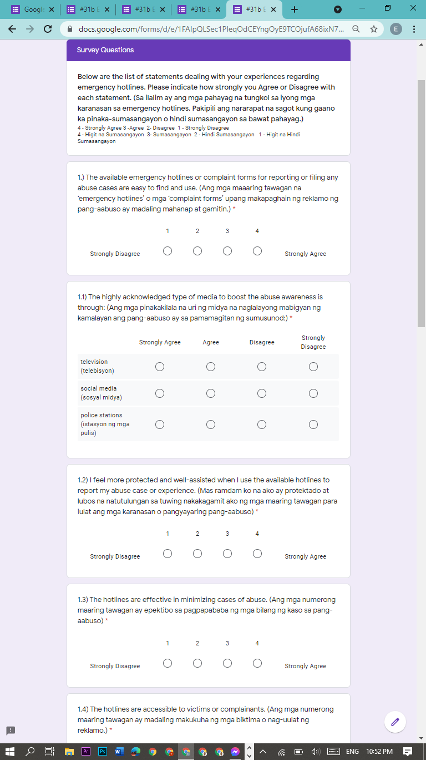
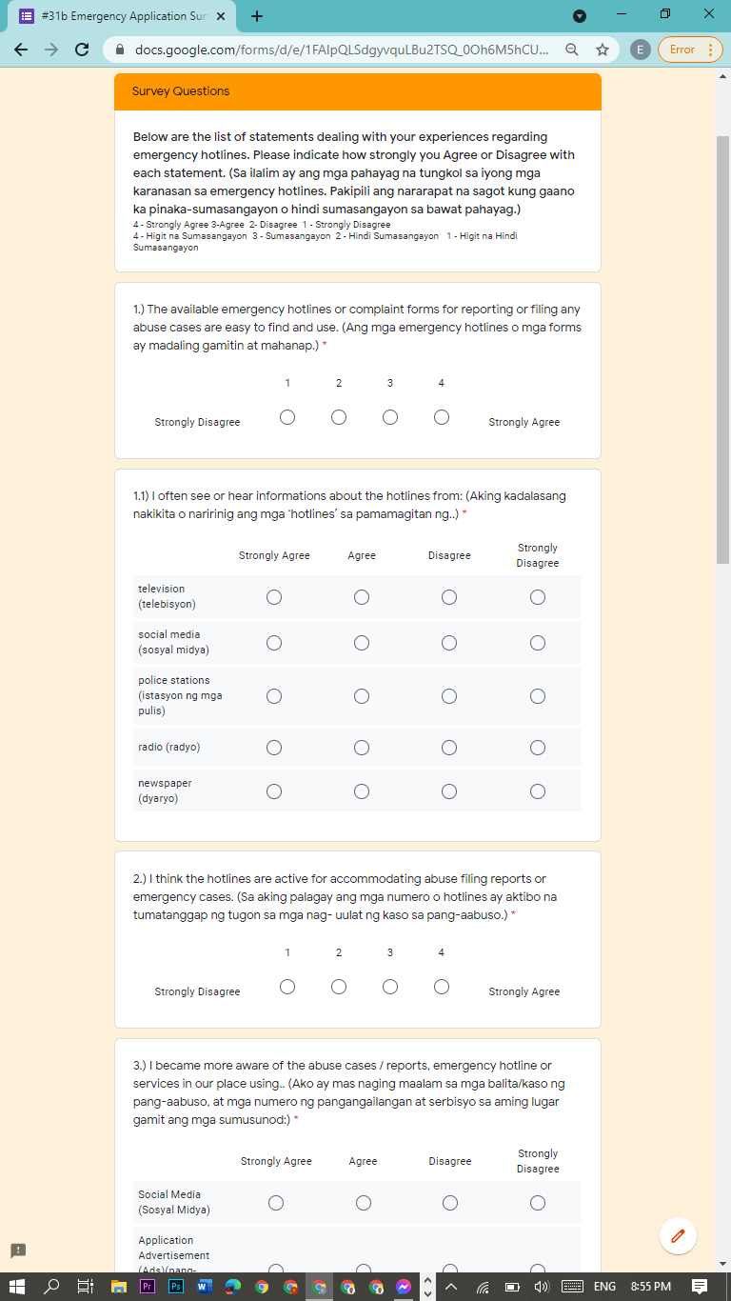
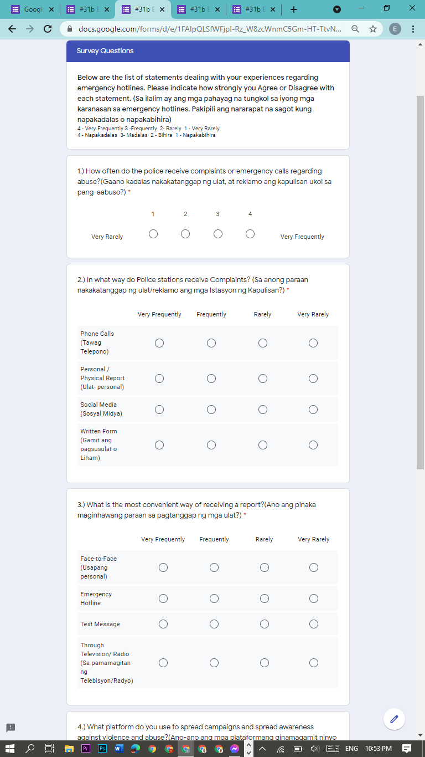
QUESTIONNAIRE
Victim/Witness
Pampanga Resident
Police Officer

Slide 13
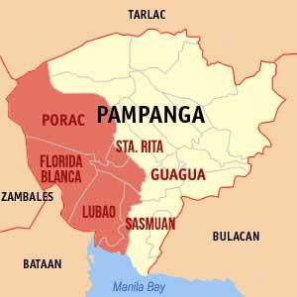

METHODOLOGY
Organizational Assessment of Subjects
RANDOM CLUSTER SAMPLING
RESPONDENTS CHARACTERISTICS
377 Respondents
2nd District of Pampanga
CONVENIENCE
SAMPLING
Thirteen (13) years old and above,
Residing in the municipalities located in the 2nd District of Pampanga
Victims or
Witnesses of Abuse
Male, Female, LGBTQ+
Police Respondents

Slide 14
METHODOLOGY
DATA ANALYSIS
The system was evaluated using the software quality standard called International Organization for Standardization (ISO) / International Electrotechnical Commission (IEC) 25010. Likert Scale was also used to analyze the statistical data from the survey questionnaires and the evaluation tool. The researchers chose a four-point scale: 1 – Strongly disagree: 2 – Disagree: 3 –Agree: 4 –Strongly Agree. The gathered data was analyzed using the weighted mean and interpreted.

Slide 15
RESULT and DISCUSSION

Slide 16
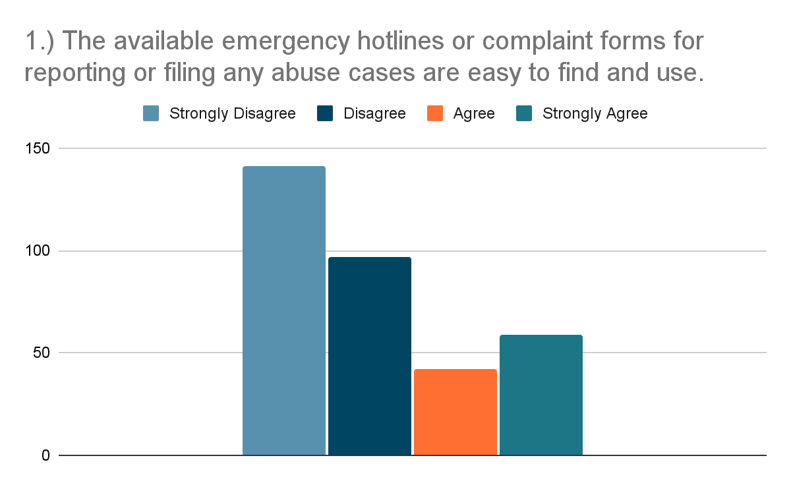
RESULT AND DISCUSSION
PRE-SURVEY RESULTS
42% of the respondents strongly disagreed and 29% of the respondents disagreed with the statement that the available emergency hotlines for filing abuse cases are easy to find and use.

Slide 17
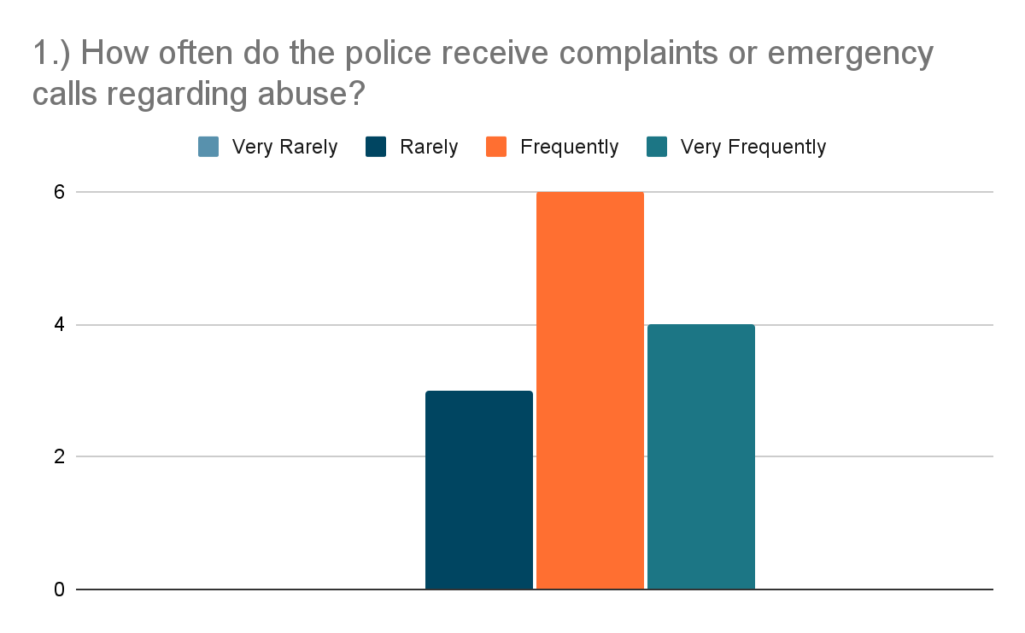
RESULT AND DISCUSSION
PRE-SURVEY RESULTS
In the figure above, the data shows that 77% of the respondents agreed that the police frequently receive complaints regarding abuse.

Slide 18
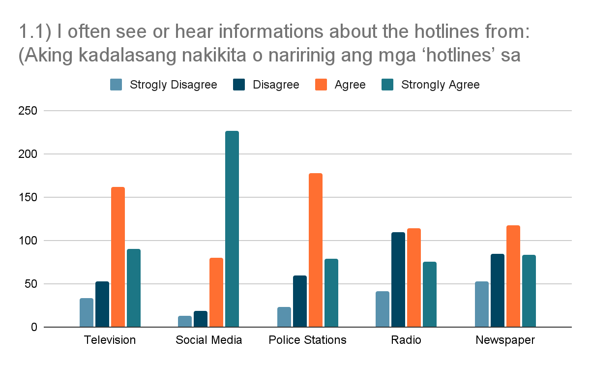
RESULT AND DISCUSSION
PRE-SURVEY RESULTS
67% of the respondents strongly agree that they often see or hear information about hotlines from social media platforms.

Slide 19
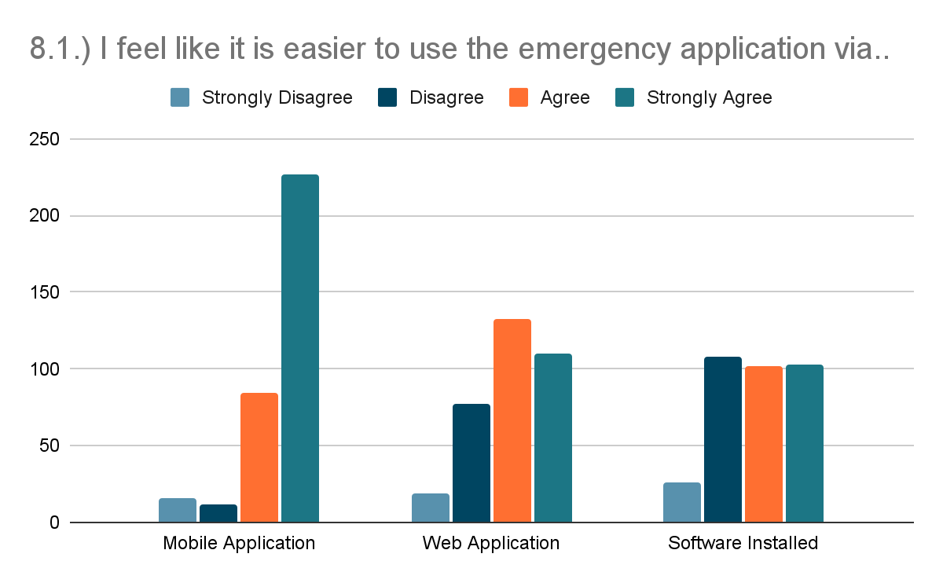
RESULT AND DISCUSSION
PRE-SURVEY RESULTS
The bar graph shows the results of the survey questionnaire for the Pampanga residents. 82% of the respondents agreed to look forward to using an application that can provide an emergency communication platform.

Slide 20
RESULT AND DISCUSSION
EVALUATION RESULTS SUMMARY
 | EXISTING SYSTEM |  | PROPOSED SYSTEM
Indicators | Mean | Interpretation | Mean | Interpretation
Functional Stability | 2.52 | Agree | 3.71 | Strongly Agree
Reliability | 2.42 | Disagree | 3.69 | Strongly Agree
Usability | 2.52 | Agree | 3.77 | Strongly Agree
Performance Efficiency | 2.48 | Disagree | 3.70 | Strongly Agree
Security | 2.65 | Agree | 3.77 | Strongly Agree
AVERAGE MEAN | 2.52 | Agree | 3.73 | Strongly Agree

Slide 21
RESULT AND DISCUSSION
EVALUATION RESULTS SUMMARY
For the summary result shown in table, the representation indicates that the proposed system impact has an average mean of 3.73, which corresponds to an interpretation level equivalent to “Strongly Agree”, specifying that the proposed system’s average mean (3.73) compared to the existing system’s average mean (2.52), with an interpretation level of “Agree”, which is shown in table. With a difference of (1.21) in the average means where in the proposed system resulted higher, this signifies that the proposed system has a greater impact and advantage to the users than the existing system in terms of functional stability, reliability, usability, performance efficiency and security.

Slide 22
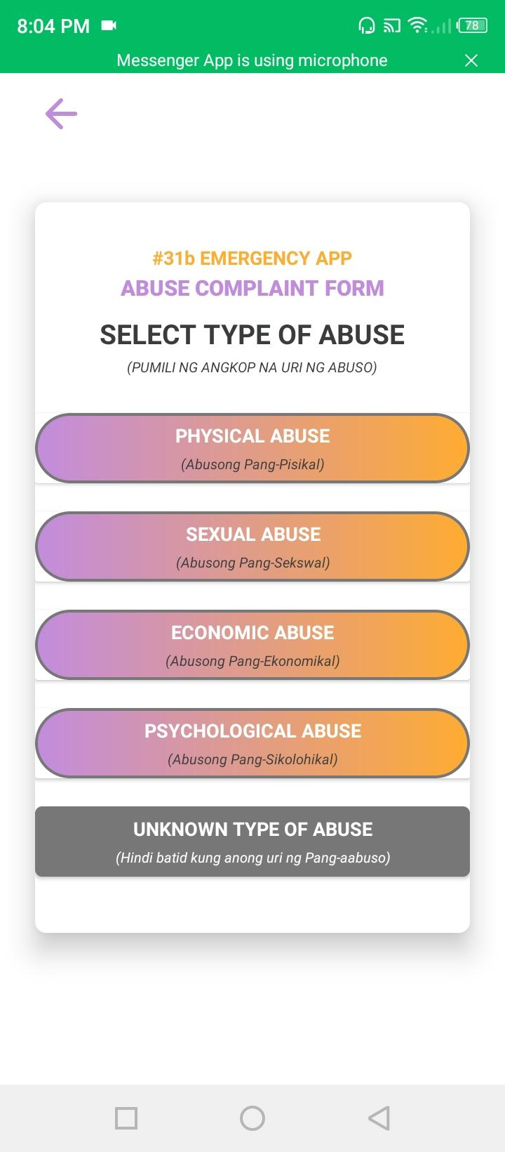
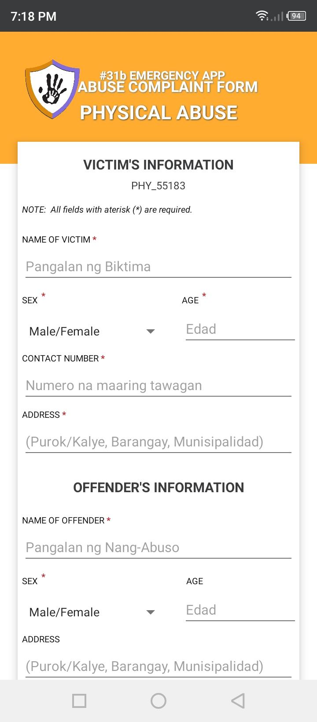
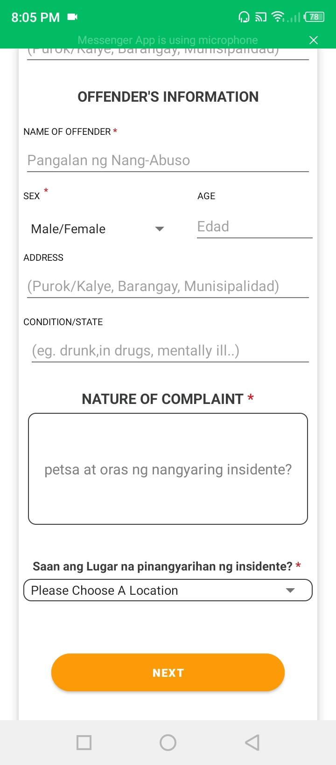
RESULT AND DISCUSSION
DISCUSSION
The application offers a complaint report function through the use of the internet.

Slide 23
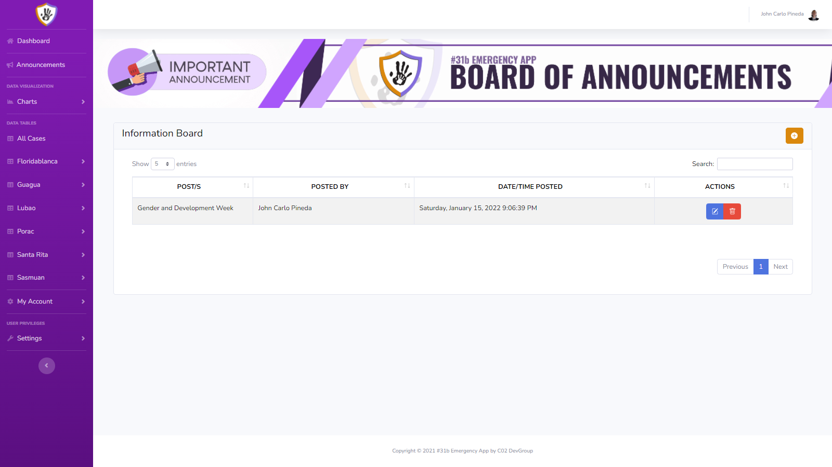
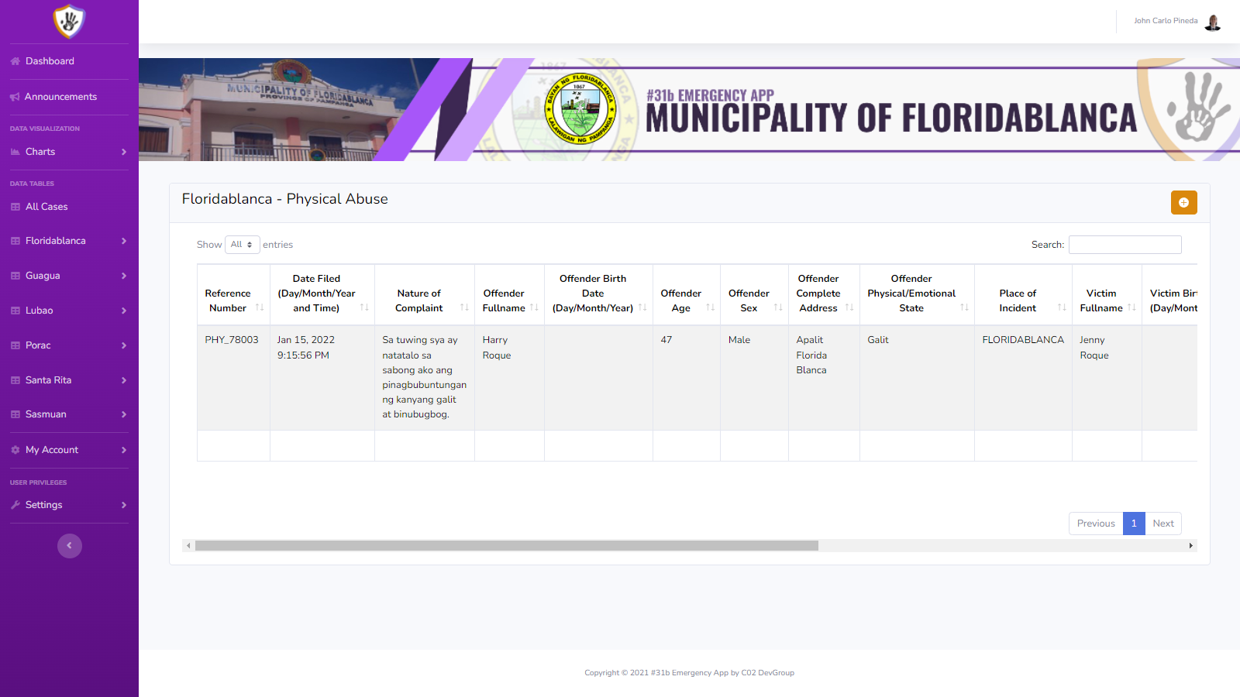
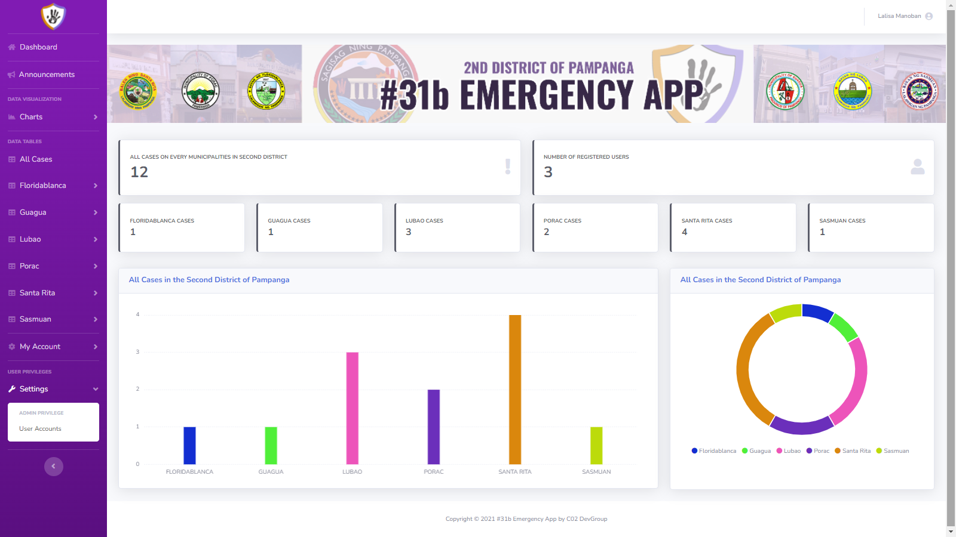
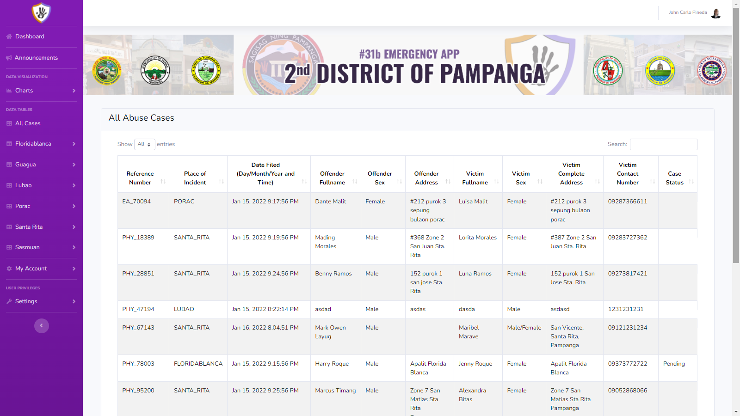
RESULT AND DISCUSSION
Through the use of the application, the database of the complaint reports will be organized as the application only focuses on submitting reports and also giving reliable information for better awareness of the people.

Slide 24
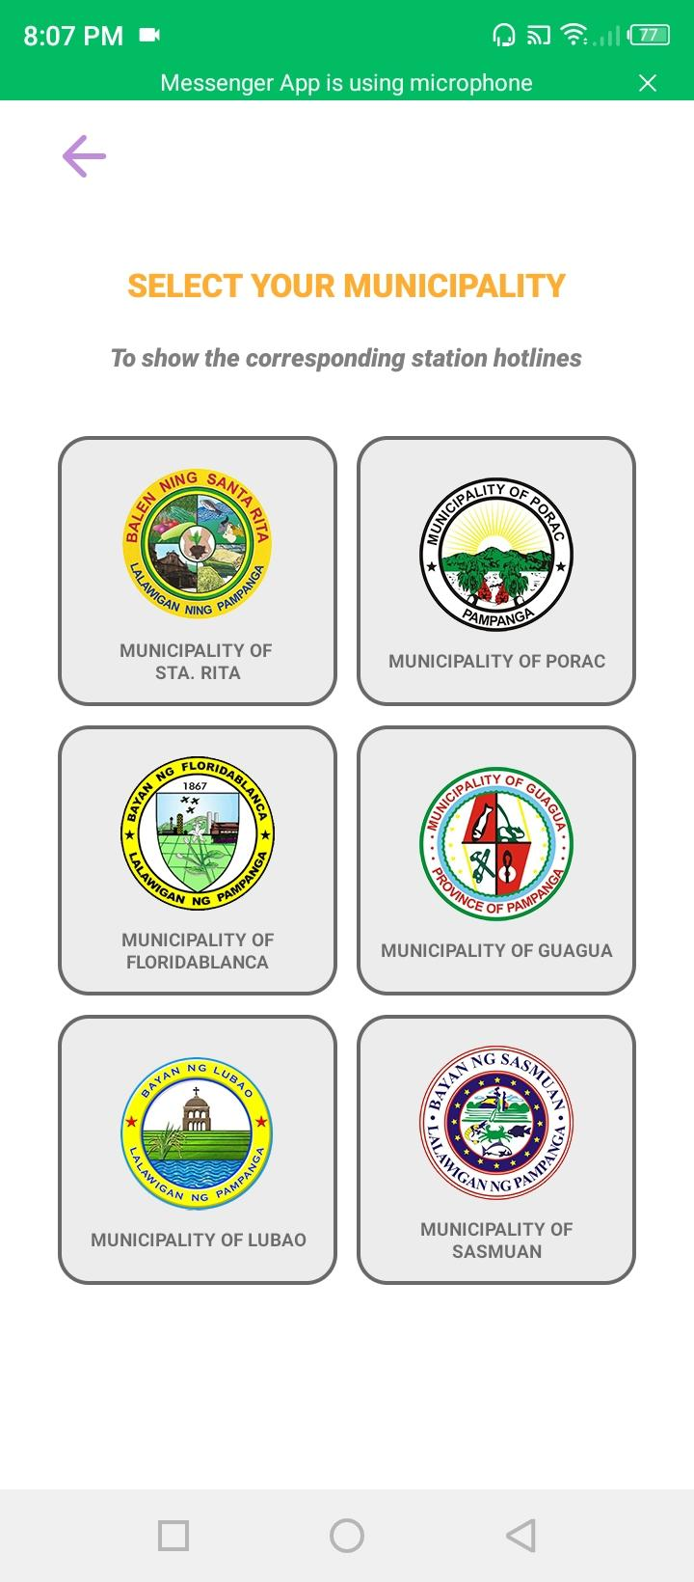
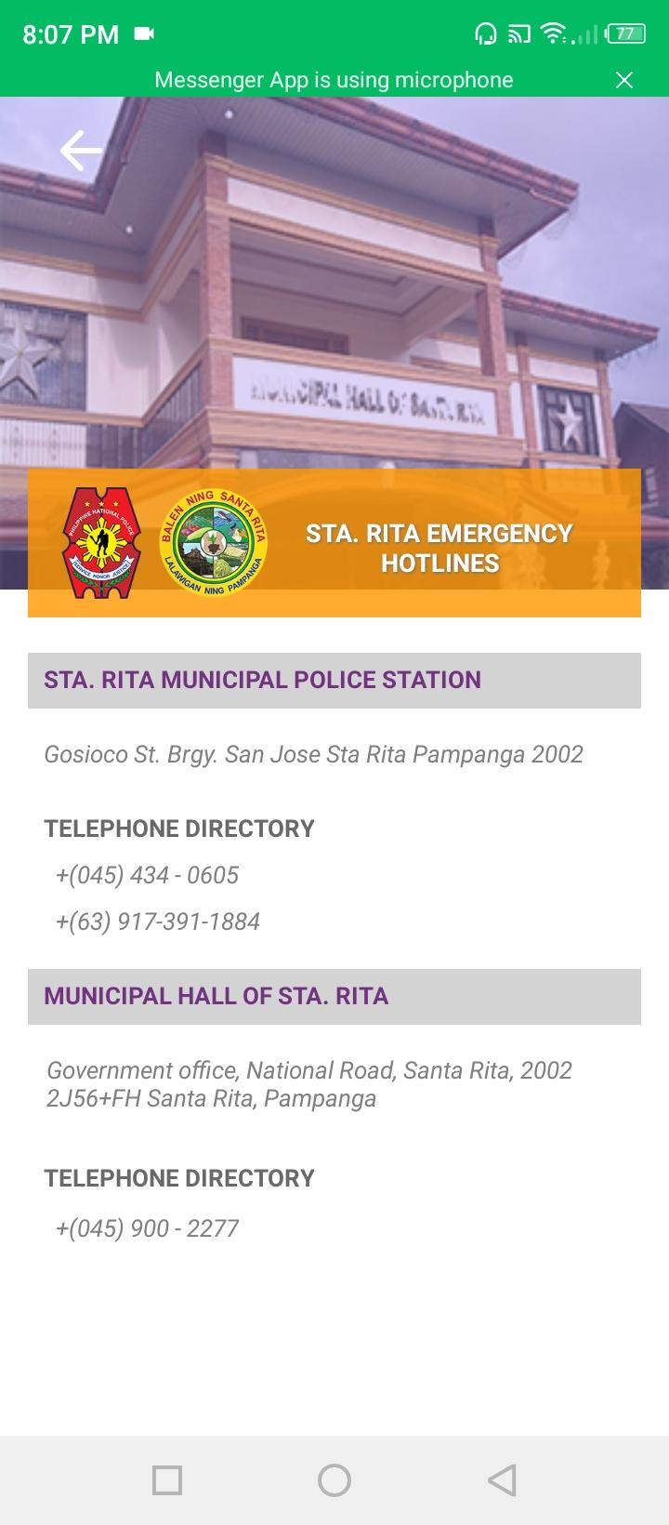
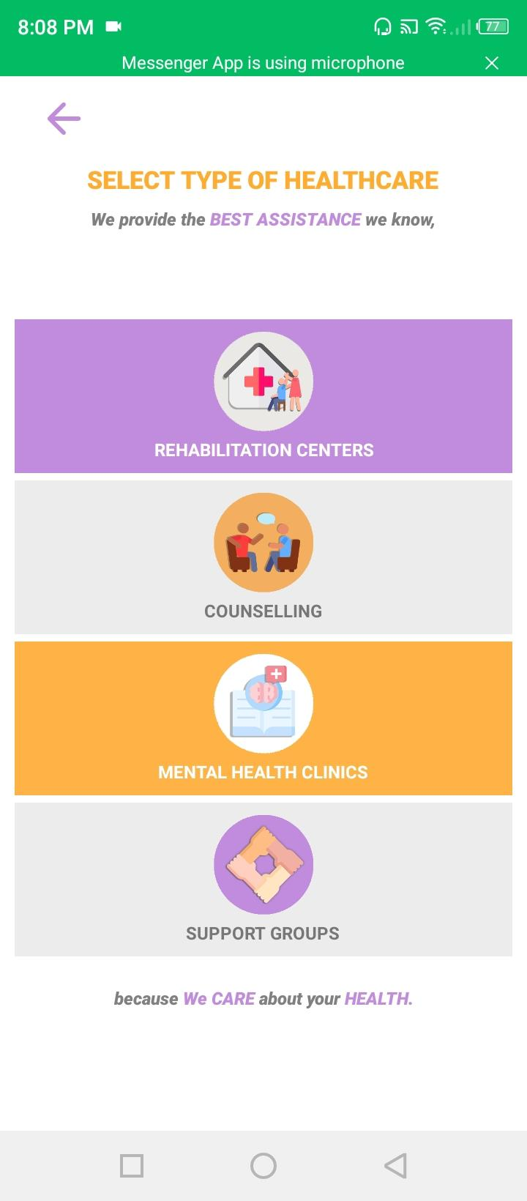
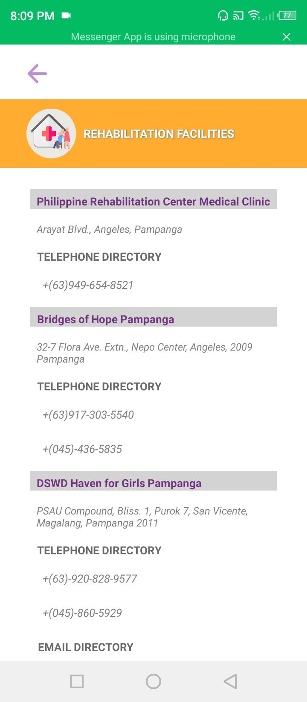
RESULT AND DISCUSSION
One of the objectives of the study is to provide accurate information about the local authorities such as telephone numbers and locations.
Also, providing the information about the nearby facilities that could help for the betterment of a person’s well-being.

Slide 25
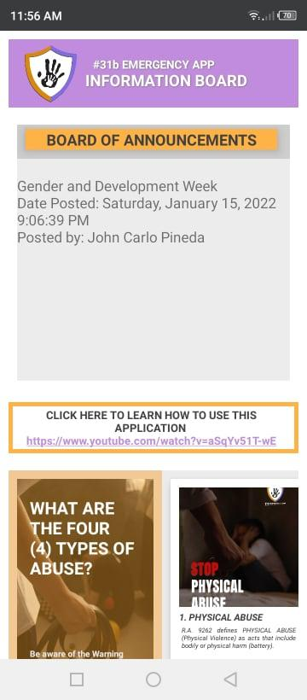
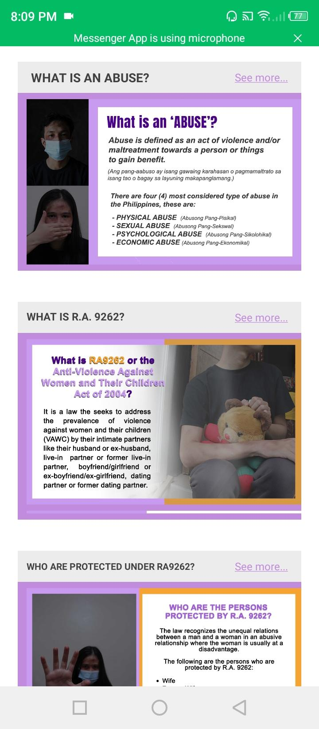
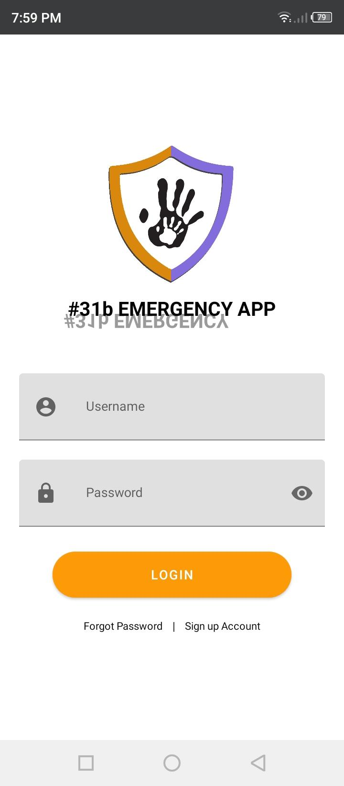
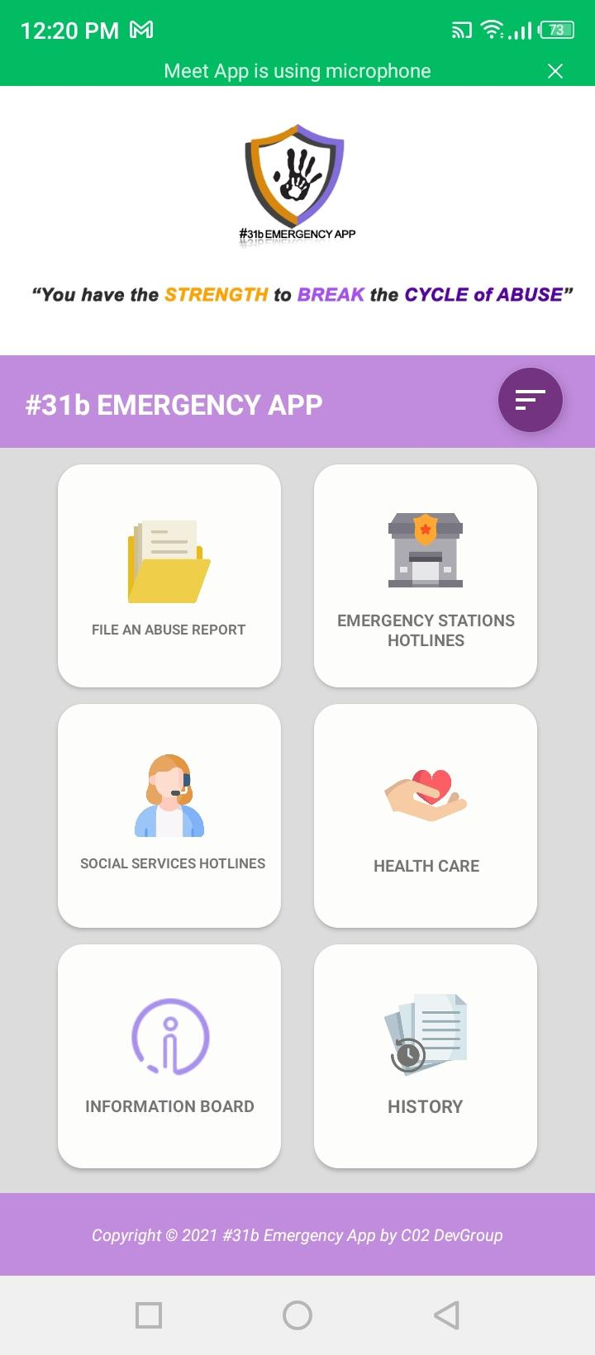
RESULT AND DISCUSSION
An information board that also tackles on how to identify if a person is being abused and what are the ways to report the abuse and stop it.
All of these are utilized in one application that will give benefit to the users.

Slide 26
CONCLUSION and RECOMMENDATION

Slide 27
CONCLUSION
The overall study was concluded successful as the aim and objective of the #31b: A 117 Emergency Communication Platform for Abuse Report in a Mobile Application was met successfully. The application was able to provide:
An additional way of submitting a complaint report to the authorities,
Providing helpful information (emergency hotlines, stations, institutions and facilities)
Also, an information board that also tackles on how to identify if a person is being abused and what are the ways to report the abuse and stop it.
The visual aesthetics of the application also helped in giving interest to the users.

Slide 28
CONCLUSION
EVALUATION RESULTS SUMMARY
 | EXISTING SYSTEM |  | PROPOSED SYSTEM
Indicators | Mean | Interpretation | Mean | Interpretation
Functional Stability | 2.52 | Agree | 3.71 | Strongly Agree
Reliability | 2.42 | Disagree | 3.69 | Strongly Agree
Usability | 2.52 | Agree | 3.77 | Strongly Agree
Performance Efficiency | 2.48 | Disagree | 3.70 | Strongly Agree
Security | 2.65 | Agree | 3.77 | Strongly Agree
AVERAGE MEAN | 2.52 | Agree | 3.73 | Strongly Agree
In the evaluation survey, the respondents Strongly Agree in terms of security with an average mean of 3.77%, usability with an average mean of 3.77% and functional stability with an average mean of 3.71%. This result signifies that the proposed system has a greater impact and advantage to the users than the existing system.

Slide 29
RECOMMENDATION
The researchers recommend implementing the study in the community by promoting the application through the use of social media and local authorities, by providing enough information on how useful the application is. The researchers also recommend the following improvements and additional upgrade features for the next researchers that would like to take the similar study.
Firstly, the adjusting and enhancement of the administrator’s website and mobile application appearance, adding more functionality for data visualization, additional language support for local users, and a new user sign-up authentication feature using the National Identification number issued by the Philippine Statistics Authority (PSA).
Secondly, is to use a different approach or System Development Life Cycle, that could possibly help the future researchers to achieve greater outcomes.
. Thirdly, the use of multi-platform application development can address the accessibility and usability to different mobile operating systems, to accommodate and help more users. Lastly, the researchers recommend to add a call feature to the application, this would enable the users to immediately report their situation. The respondents found the application useful despite of its shortcomings. The process of improving the application features continues as it is being implemented in the community

Slide 30
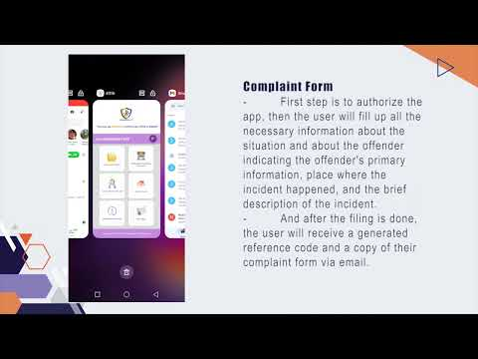
#31b Mobile Application

Slide 31
ACKNOWLEDGEMENT

Slide 32




The researchers would like to acknowledge the support and help of the following institutions:
DOST

Slide 33



THANK YOU!
GROUP CO2
Alonzo, Arlene Grace C. Belleza, Ram Rainier M. Dela Cruz, Diane Louise M. Magat, Mharck Stephen P. Mañalac, Gerald O. Pineda, John Carlo C. Soriano, Justine G.
BSIT- 4A

